Slide 1
IMPLEMNTATION OF HASH TABLE DATA STRUCTURE
Presented By:
RAUNAK PODDAR(2K21/ISY/20)
KARAN YADAV (2K21/ISY/11)

Slide 2
Introduction
A Hash Table is a data structure that maps keys to values. A Hash table is an array of items, which themselves are a {key: value} pair.
Hash Table uses a hash function to compute indexes for a key and based on the Hash Table index, we can store the value at the appropriate location.
While mapping the keys if two different keys get the same index then that is known as Collision.
Our first step is to choose a reasonably good hash function that has a low chance of collision.
The whole benefit of using a Hash Table is due to it’s very fast access time. On an average the the time complexity is a constant O(1) access time. This is called Amortized Time Complexity.

Slide 3
Aim
Our aim is to design a Hash Table which have the following features:
A good Hash function to map keys to values. A Hash function is said to be good Hash Function if that function gives least collision.
The hash function that "uniformly" distributes the data across the entire set of possible hash values.
A Hash Table Data Structure that supports insert operation, search operation and delete operation.

Slide 4
IMPLEMENTATION
Step 1: In the very first step we will create item. We will call a user defined function create_items(key,value).
Step 2: We will find index of that Hash Table. We will call the int index = hash_functions(key) and store the {key,value} pair in that index position.
Step 3: We should make sure that index position is NULL. If the index position is not NULL then it will result in collision.
Step 4: We will also track the record of number of elements in the Hash Table and capacity of the Hash Table. This will help us yo find if the Hash Table is full or not.
Step 5: We will then Create the Hash Table and its items. We define functions to create a new Hash table into memory and also create its items.
Ht_item* create_item(char* key, char* value)

Slide 5
IMPLEMENTATION
Step 6: Step 6: Insertion in Hash Table: We will create a function ht_insert() that performs this task for us.
This takes in a HashTable pointer, a key and a value as parameters.
void ht_insert(HashTable* table, char* key, char* value);
Step 7: Searching in Hash Table : Search Items in the Hash Table
If we want to check if the insertion was done correctly, we also need to define a search function, that checks if the key exists or not, and returns the corresponding value if it does.
char* ht_search(HastTable* table, char* key);
Step 8: Handling Collision. We will briefly discuss the collision Handling in next page.

Slide 6
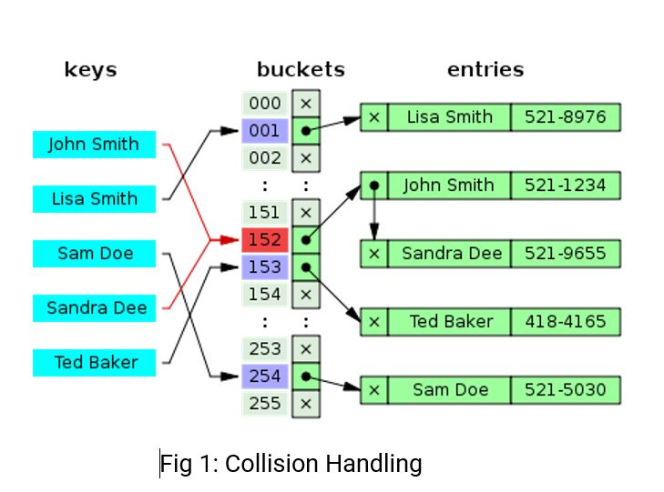
Collision Handling
There are different ways through which a collision can be resolved. We will look at a method called Separate Chaining, which aims to create independent chains for all items that have the same hash index.
We will create these chains using Linked Lists.
Whenever there is a collision, we will add further items that collide on the same index on an Overflow Bucket List. Thus, we will not have to delete any existing records on our hash table.
Due to linked lists having O(n) time complexity for insertion, searching and deletion, in case of a collision, we will have a worst-case access time of O(n) as well. The advantage of this method is that it is a good choice if your hash table has a low capacity.

Slide 7
Separate Chaining Analyzation
This strategy uses an array of linked list implementation. It could also use other data structures other than linked lists.
Here, many linked lists are connected or chained to various cells of the hash table. This tends to cause some problems especially tracking these linked lists. For example, if a hash table has 2500 cells, it implies there will also be a maximum of 2500 linked lists (if collisions occur in all the cells) which are obviously very difficult to track [6].
The separate chaining comes with some advantages like: Efficient collision resolution , Insertion, Searching andf Deletion is easy , Table size need not be a prime number [6].
It also has some disadvantages like: Separate data structure for chains required and code to manage it, Extra space required for linked lists , Creating new nodes is expensive and slows down the machine for some languages .

Slide 8
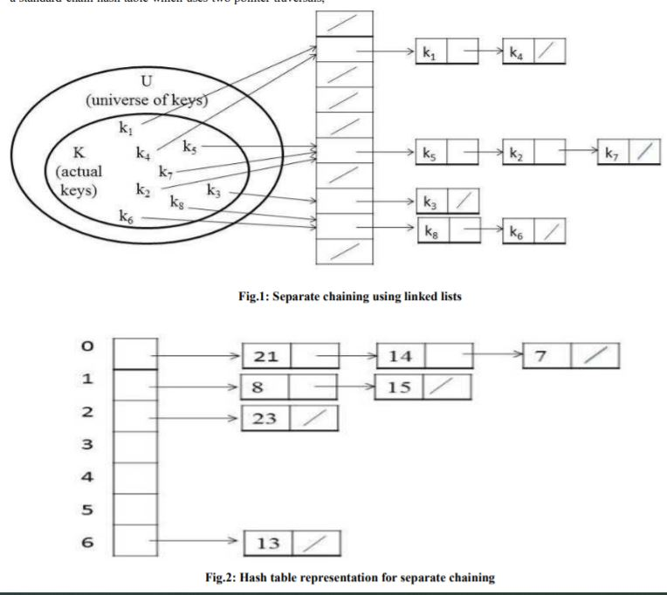
Analyzation Contd…
Loading the keys 23, 13, 21, 14, 7, 8, and 15, in a hash table
of size 7 using the separate chaining using linked lists, the
following hash values emerge.
h(23) = 23%7 = 2
h(13) = 13%7 = 6
h(21) = 21%7 = 0
h(14) = 14%7 = 0 collision
h(7) = 7%7 = 0 collision
h(8) = 8%7 = 1
h(15) = 15%7 = 1
The hash table representation is depicted in Figure. 2
Fig: 2 Hash Table using separate Chaining

Slide 9
Conclusion
In this project we have tried to implement the Hash Table from scratch without using any single inbuilt function for Hash Table.
We have successfully implemented Insertion. Searching and deletion operation in Hash Table.
Collision Handling is one of the major challenge in this project.
Removal of collision is not possible. But we tried to handle the collision in such a way so that we get least collision.
For collision Handling, We have implemented the concept of Separate Chaining.

Slide 10
Reference
[1] Teschner, Matthias, Bruno Heidelberger, Matthias Müller, Danat Pomerantes, and Markus H. Gross. "Optimized spatial hashing for collision detection of deformable objects." In Vmv, vol. 3, pp. 47-54. 2003.
[2] Nimbe, Peter, Samuel Ofori Frimpong, and Michael Opoku. "An efficient strategy for collision resolution in hash tables." International Journal of Computer Applications 99, no. 10 (2014): 35-41.
[3] https://www.geeksforgeeks.org/
[4] The Joys of Hashing: Hash Table Programming Using C By Thomas Mailund
[5] Let Us C: Authentic Guide To C Programming Language By Yashwant Karnetkar

